Slide 1
CURA HOSPITAL MANAGEMENT SYSTEM
FALL 2022 CAPSTONE PROJECT
PROF. - HENRY WONG

Slide 2
AGENDA
TEAM INTRODUCTION
PROBLEM STATEMENT
PROJECT DESCRIPTION
TECHNOLOGY
PERSONAS
PROJECT SCHEDULE
RETROSPECTIVE
WIKI PAGE

Slide 3
TEAM INTRODUCTION
SAI TEJA KORIBILLI
SHIVANSH TOMAR
MOUNIKA KRISHNA THALLA
JIGAR J SHAH
KULDEEP RAJ KALUVALA
BINDHU VALISHETTY
SAI NIKIL KESIREDDY

Slide 4
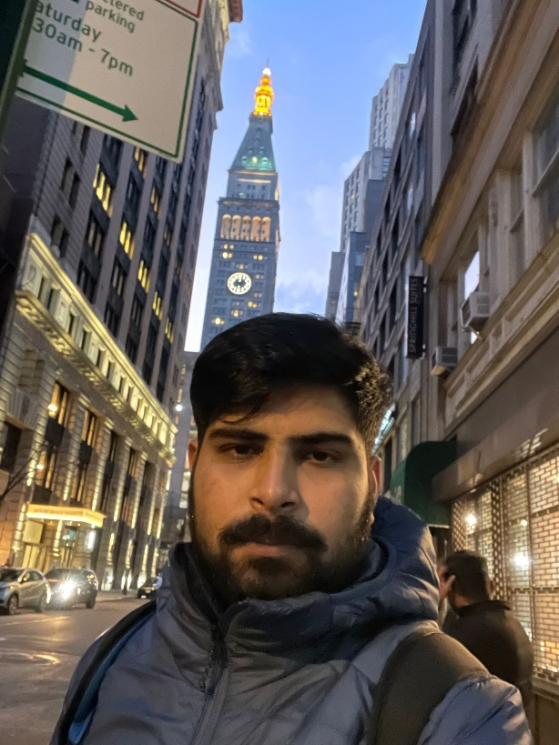
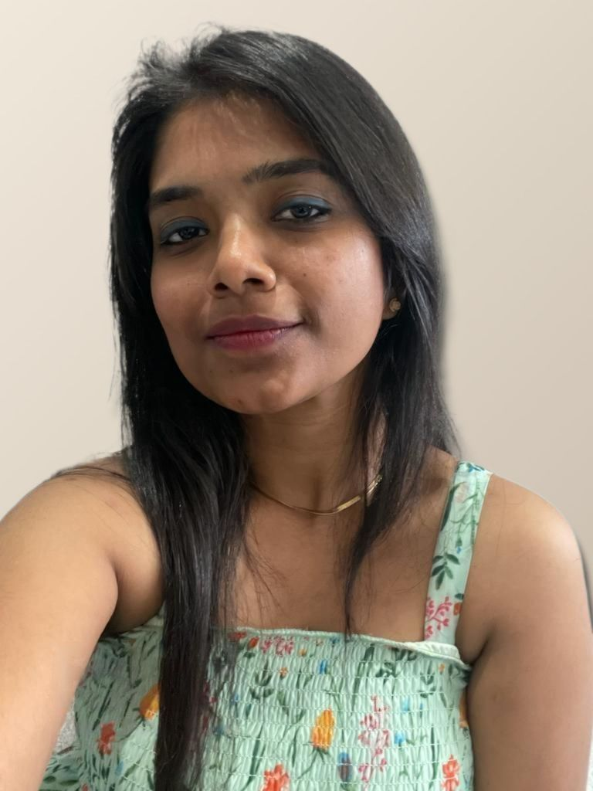

Team Introduction
Shivansh Tomar Developer
Mounika Thalla
Project Manager Quality Analyst
Jigar Shah
Developer

Slide 5
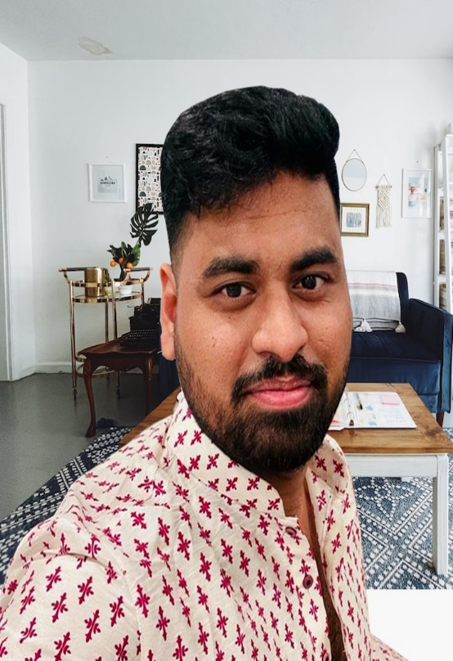

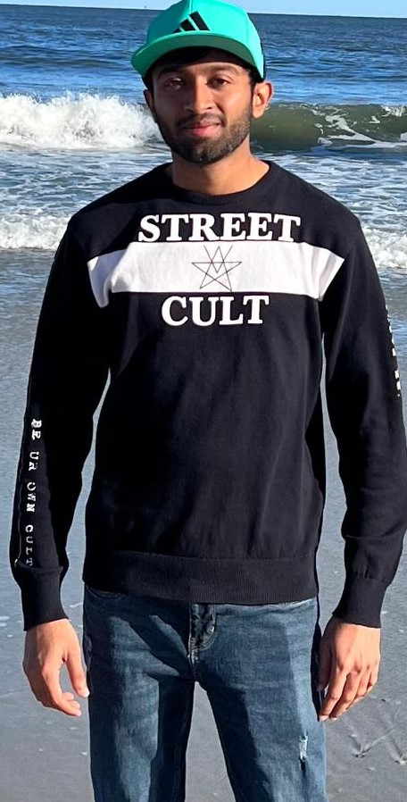
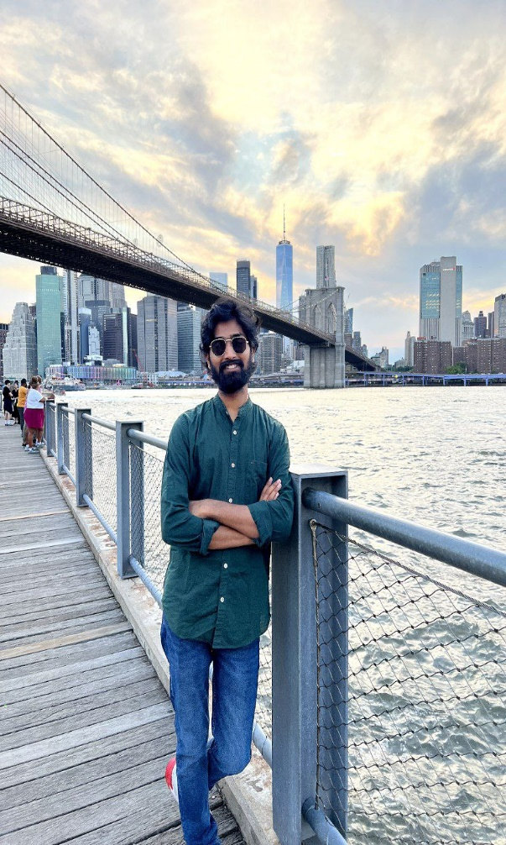
Team Introduction
Kuldeep Raj Kaluvala
Developer
Bindhu Valishetti Developer
Nikhil Kesireddy
Business Analyst & QA
Sai Teja Koribilli
Scrum Master & DBA

Slide 6
PROBLEM STATEMENT
Managing the massive volumes of patient related data is exhausting.
Absence of supply management system.
Inefficiency and errors in data sharing.
Patients who don’t have access to a healthcare center.
Lack of transparency.

Slide 7
PROJECT DESCRIPTION
The project Hospital Management System includes patient registration, data storage in the system, and computerized billing in the pharmacy and labs.
The web-application has the capability of assigning a unique id to each patient and automatically storing the details of each patient and staff member.
It has a search function to determine the current status of each room. Using the id, the user can look up a doctor's availability and patient information.

Slide 8






TECHNOLOGIES

Slide 9

Personas
Doctor
Tori is a doctor who is working at New York Health Center.
She will be having 30 to 40 appointments with patients everyday.
It is very hard to keep track of the appointment details and other information related to patient.
So by using hospital manage system, she can access the details of appointments easily.

Slide 10
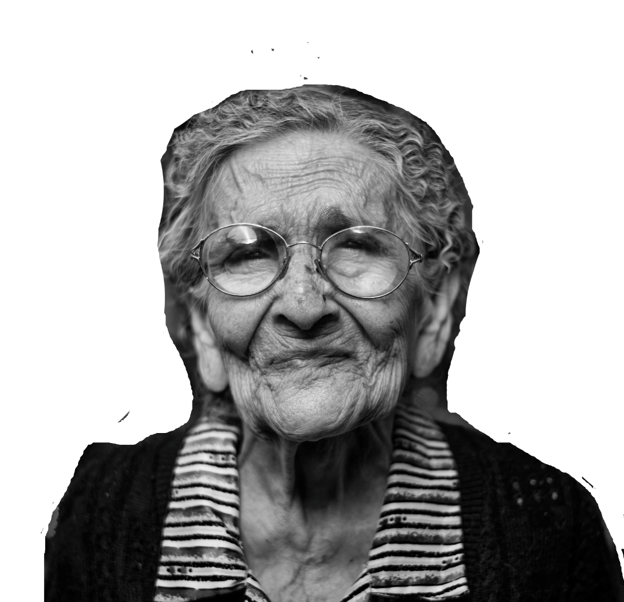
Personas
Patient
Mary is 81 years old.
She is suffering from auto-immune disease, lyme disease and asthma. Lives in Aurburn in Alabama, US.
Undergoes checkup every month ,But every time she has to fill appointment form and wait hours for the doctor.
By using Hospital management system, she can fill her details once and book appointment with doctor easily.

Slide 11

Personas
Inventory Management
Jack is an inventor who works in Osmania hospital in UK .
He maintains the records of medical equipment's, drugs and surgical equipment.
He need to keep track of these items every day for smooth running of operations.
Using hospital management system, she can maintain database for this items and access their availability easily.

Slide 12

Personas
Admin
Henry is an admin of Texas State Hospital.
He plays a key role in the hospital management.
He manages the scheduling and appointments of doctors.
He plans departmental activities, evaluate doctors and other hospital employees, patient services
He creates and deletes all the roles.
By using hospital system management, he can organize the above activities easily.

Slide 13

Personas
Pathologist
Omar is a pathologist who works in Ozone hospital in Greece
He collects the samples from patient and examines them .
After examining the samples of patient, he stores the data of patient.
By using Hospital System management, the doctor and the patients can easily access these data and gets insights from those reports

Slide 14
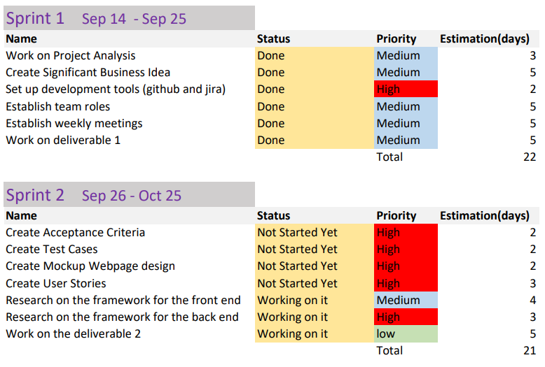
Project Timeline

Slide 15
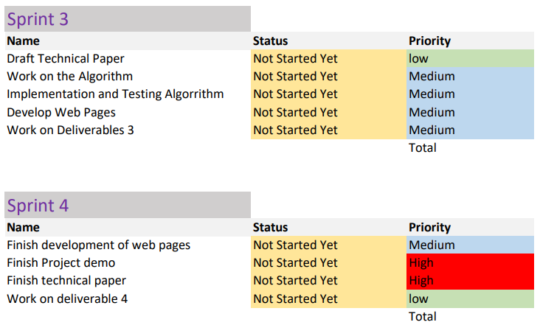
Project Timeline

Slide 16
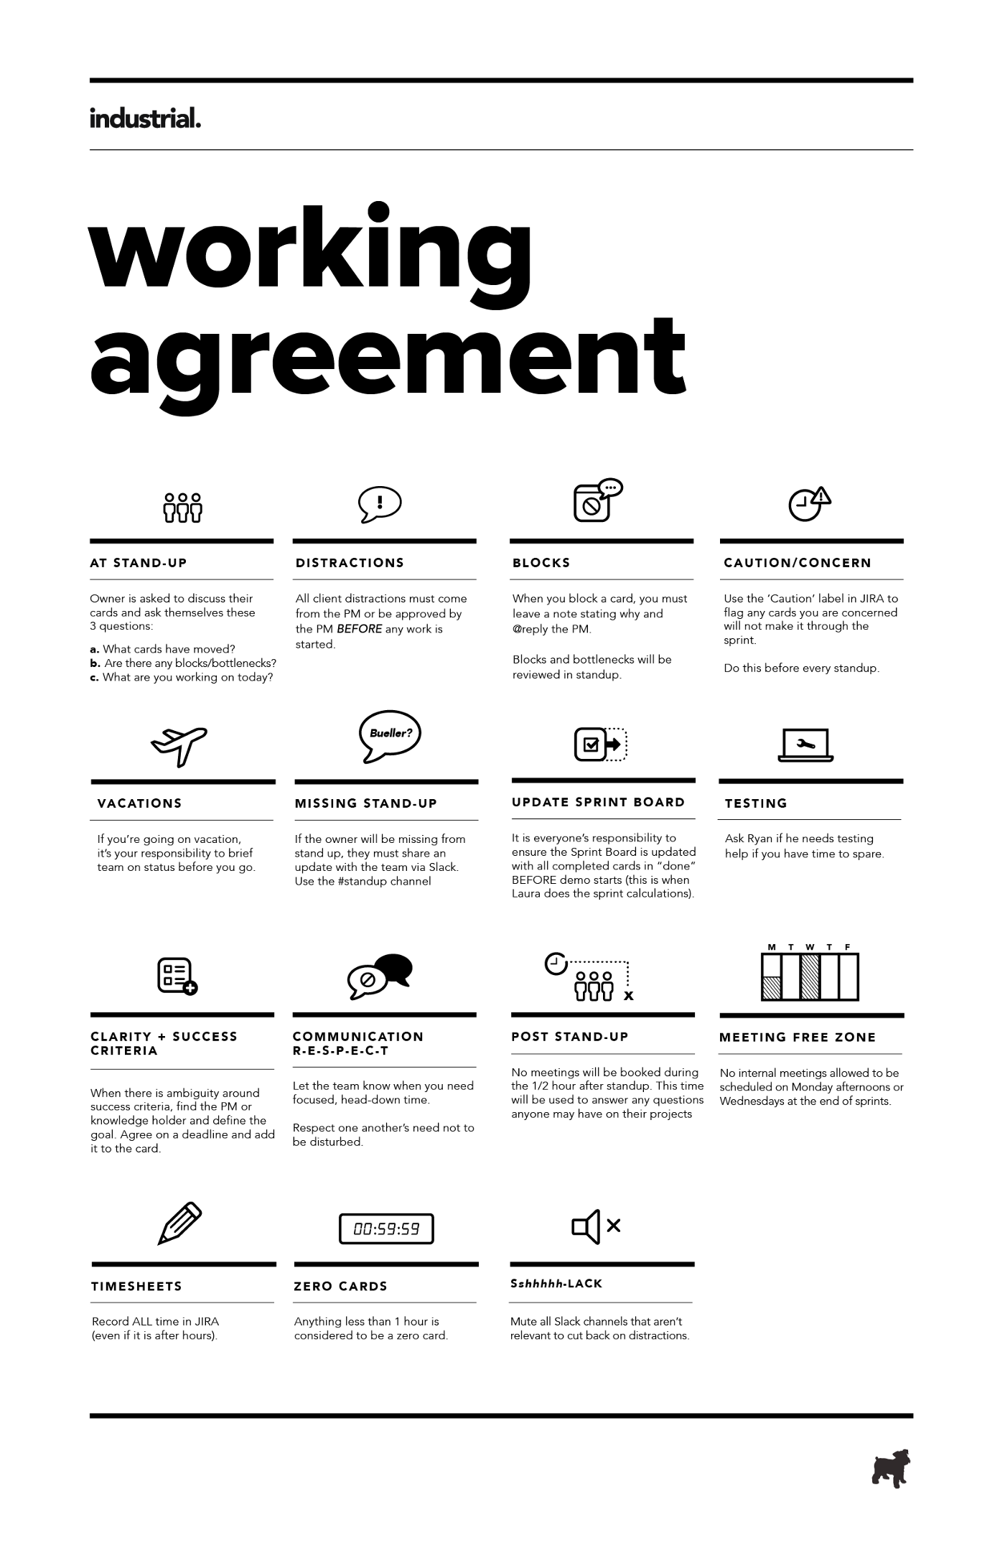

Working Agreement

Slide 17
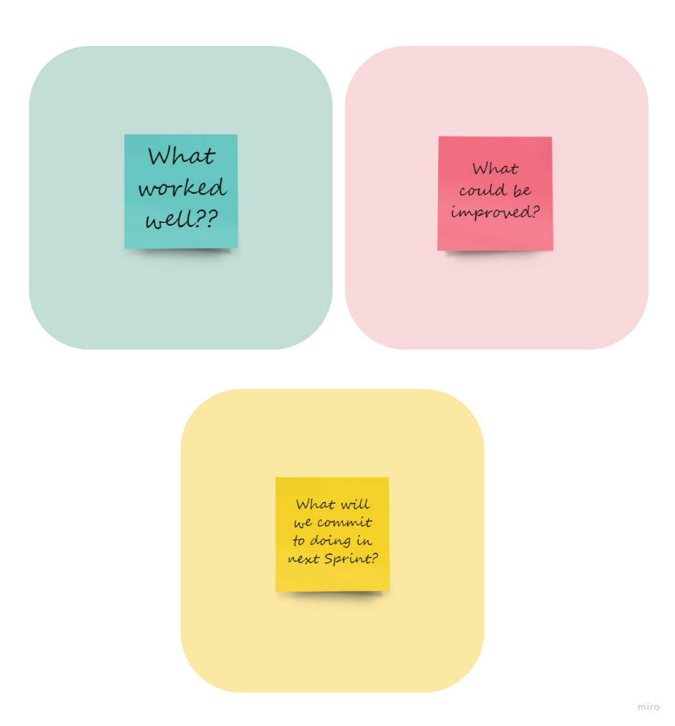
Retrospective

Slide 18
Retrospective
What went well?
We as a team have planned to keep our objective simple to finish and produce what was expected.
Team had good time working together.
Active response from team to get involved in tasks with clear thoughts.
The key was participation and motivation to complete task in time and every member knew what they had to do.
We had several discussion sessions.
Overall, every meeting session is effectively used to gain progress and complete sprint on time.

Slide 19
Retrospective
What could be improved?
We frequently try to communicate to discuss about project and advancements even after the sprint completion.
Setting up time limit for the tasks and learning from previous sprints performance to make improvements and where can we be better.
What will we commit to doing in the next sprint?
Maintain consistency in performance, improvement is key.
Previous sprint retro can be helpful for improving team balance in which areas team is lacking, where we can work according to that.
Previous retro stats can be helpful in filling the gaps of next sprint.

Slide 20
Wiki Page
https://github.com/SaiTejjj/HMS/wiki/CURA---HMS

Slide 21
Thank You🙂

